Slide 1

Witbank Property Price Analysis
Exploratory Data Analysis & Regression Modelling
By: Lwandile Ranela
Date: 04/08/2025

Slide 2
Objective
The purpose of this analysis was to understand which factors most strongly influence residential property prices in Witbank and to quantify their effects
I aimed to answer:
1, How much do location, size, bedrooms, bathrooms, and garages contribute to property value?
2. Which suburbs have the highest premiums and which are significantly undervalued?
3. How accurately can a regression model predict property prices based on these features?
The end goal is to provide actionable insights for investors, developers and real estate agents, enabling data-driven decision-making in pricing, marketing, and property development

Slide 3
Dataset & Cleaning Process
Source: Property24 listings for Witbank
Variables collected: Price, Size (m²),, Bedrooms, Bathrooms, Garages, Location
Cleaning steps:
Removed “m²” and spaces from Size, converted to numeric.
Filled missing values: Garages = 0 (assumed no garage because it may be an apartment), Bedrooms = median, Bathrooms = mode.
Standardised locations (merged variants like “Bankenveld Estate” and removed “Ext” suffixes).
Dropped remaining null records.
This ensured that the analysis was performed on a complete, consistent, and standardised dataset, ready for statistical modelling.

Slide 4
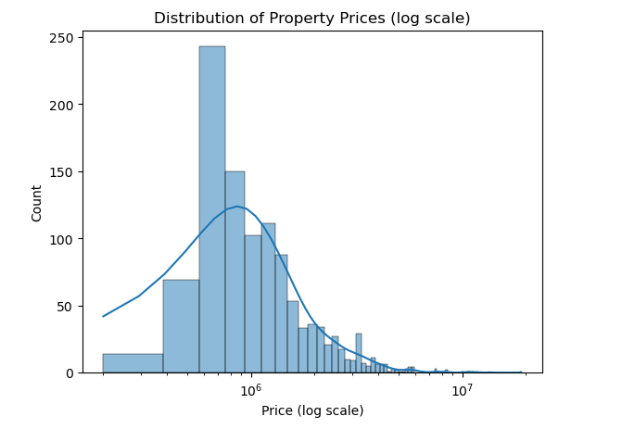
Price Distribution
The distribution of property prices his highly right-skewed.
Most properties are prices between R500,000 & R2,000,000.
A small number of outliers above R5 million significantly inflate the average.
To better visualiSe the spread and reduce distortion from extreme values, the price was plotted on a logarithmic scale.
Implication: While the majority of properties are affordable to middle-income buyers, there exists a niche luxury market that commands multi-million rand prices

Slide 5
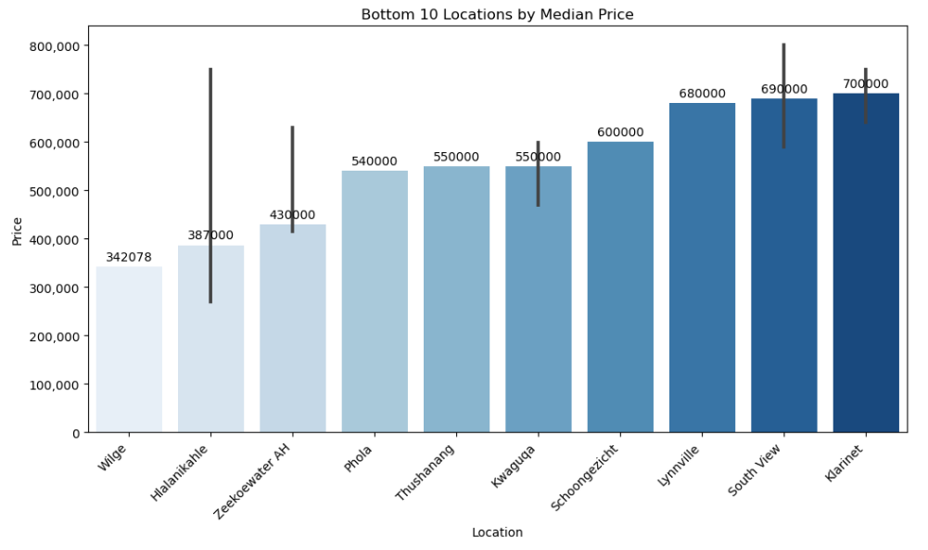
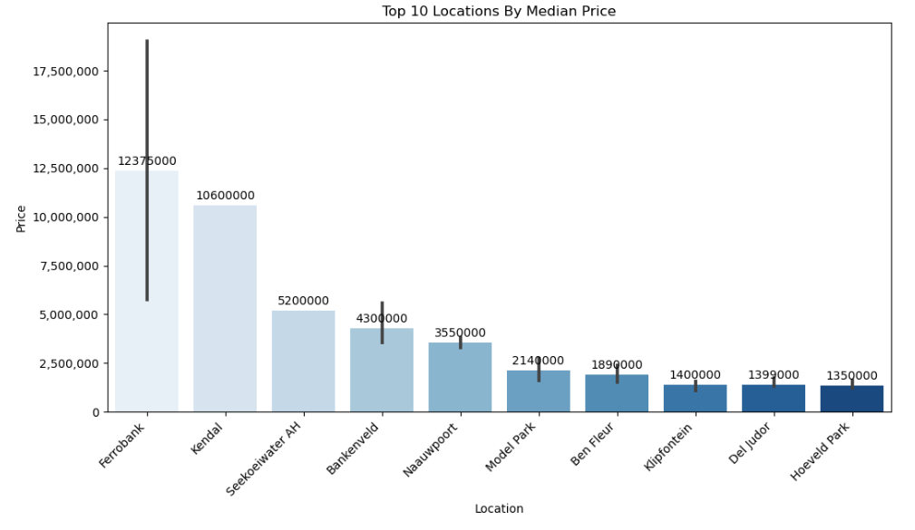
The Power of Location
Suburb level analysis showed large differences in median prices
Top suburbs by median price:
Ferrobank: 123,750,000
Kendal: R106,000,000
Seekoeiwater AH:R5,200,000
Lowest suburbs by median price:
Wilge: R34078
Hlalanikahle: R387,000
Zeekoewater AH: R430,000
Location is the most significant factor in Witbank property valuation, overshadowing the impact of property

Slide 6
How Features Relate to Price
Bedrooms vs Price:
Adding bedrooms generally increases value, but returns taper beyond 4-5 bedrooms.
Bathrooms vs Price:
Bathrooms show a steeper price rise per additional unit than bedrooms
Average premium per bathroom: R189,000
Garages:
Jump from 0 to 2 garages can add over R200,000 to property value
Size vs Price:
Larger properties cost more, but location often outweighs size in price determination

Slide 7
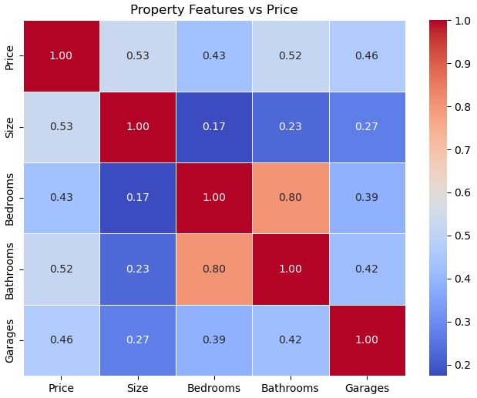
Feature Correlations
The correlation analysis revealed:
Bathrooms: 0,49 correlation with price
Garges: 0,44
Bedrooms: 0,41
Size: 0,37
All features are positively correlated, but bathrooms lead, suggesting buyers prioritise comfort and convenience.
Size has the lowest correlation, reinforcing that location and amenities play a bigger role than just the floor space.

Slide 8
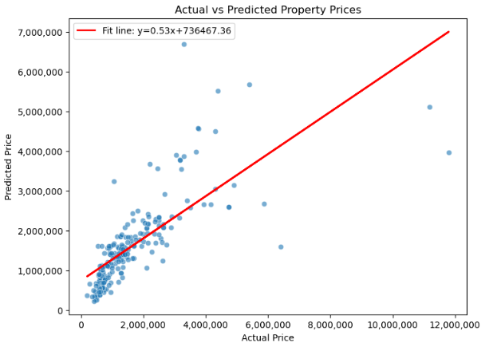
Regression Model Performance
Model type: Multiple Linear Regression
Predictors: Size, Bedrooms, Bathrooms, Garages, Location, (one-hot encoded)
Results:
R² Score: 0,538 – the model explains approximately 54% price variation
Mean Absolute Error: R494,099
Interpretation: Model performs well considering property condition, age, and street level location data amongst other factors, were not included.
High error margin shows that there are hidden variables that the dataset does not capture

Slide 9
Key Insights & Recommendations
Insights:
1. Location is king – price gap exceeds R10 million between Witbank suburbs
2. Bathrooms and garages add more value than bedrooms or size
3, Model explains just over half the variation in price – richer datasets could greatly improve accuracy
Recommendations:
Investors: Target high-premium suburbs for stability or undervalued suburbs for potential growth.
Developers: Add extra bathrooms and garages in new builds to raise value
Future analysis: include property condition, age, proximity to services, and recent sales trends.

